Slide 1
Optimizing Spark: Storage, Partitioning, and Caching
Lesson 22.3
‹#›

Slide 3
Class Objectives
By the end of this lesson, you will be able to:
Understand how partitioning affects Spark performance.
Explain the cause of shuffling and limit it when possible.
Identify when caching is the best option.
Explain how to broadcast a lookup table, and force it when it doesn't happen automatically.
Set the shuffle partitions to an appropriate value and demonstrate how to cache data.

Slide 4
Optimizing Spark — Data Storage
Notes:
1. Optimizing Spark - Data Storage

Slide 5

Introducing Parquet
Notes:
📣 1.1 Instructor Do: "Rows? Where we are going we don't need 'rows'!"

Slide 6
While Spark will always partition data across it’s workers, there are strategies to optimize how the data is stored that can greatly improve Spark performance and reduce costs.

Slide 7

Spark: Supported Languages and More
Spark can be programmed in Scala, Python, Java, R, and SQL.
It has a rich ecosystem and is very scalable.
JDBC
Console
User Programs
(Scala, Python, Java, R, and SQL)
Spark SQL
DataFrame API
Catalyst Optimizer
Spark
RDDs

Slide 8
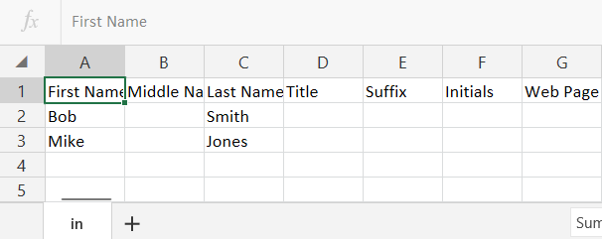
Optimizing Spark — Data Storage
When Spark loads data from a CSV file it will distribute the data through different nodes. Each node will then assign rows of the CSV file to a partition. When we query the data using a Spark API, every value has to be read from each partition.
The better option for both delimited and JSON data, is to use
https://www.howtogeek.com

Slide 9
Parquet is a splittable, columnar format that works well in distributed storage like, HDFS, AWS S3, and Azure data lake storage (ADLS).

Slide 10
Optimizing Spark — Data Storage
Columnar refers to how the data is stored.
🍏 | 🍏 | 🍏 | 🍏 | 🍏
💛 | 💛 | 💛 | 💛 | 💛
🔹 | 🔹 | 🔹 | 🔹 | 🔹
▶ | ▶ | ▶ | ▶ | ▶
✸ | ✸ | ✸ | ✸ | ✸
🍏 | 💛 | 🔹 | ▶ | ✸
🍏 | 💛 | 🔹 | ▶ | ✸
🍏 | 💛 | 🔹 | ▶ | ✸
🍏 | 💛 | 🔹 | ▶ | ✸
🍏 | 💛 | 🔹 | ▶ | ✸
🍏 | 💛 | 🔹 | ▶ | ✸
🍏 | 💛 | 🔹 | ▶ | ✸
🍏 | 💛 | 🔹 | ▶ | ✸
Columnar stores each column of a row separately, with a reference to all of it’s columns.
This allows you to query and filter a single column and return only the selected columns in your query with great efficiency.
This will greatly reduce the amount of reading Spark would have to do.

Slide 11
Row Based vs Columnar Based (Parquet)
Select city from Table where state = “NY”
1
2
3
4
1
2
3
4
1
2
3
4
1
2
3
4
1 = Bob , Irvine, CA, Pizza
2 = Sue, Hamilton, NY, Sushi
3 = Marge, Springfield, MO, soup

Slide 12
Row Based vs Columnar Based (Parquet)
Select city from Table where state = “NY”
A1
B1
C1
1
A1
B1
C1
2
A1
B1
C1
3
A1
B1
C1
4
1
2
3
4
2
1
2
3
4
1 = Bob , Irvine, CA, Pizza
2 = Sue, Hamilton, NY, Sushi
3 = Marge, Springfield, MO, soup

Slide 13

Optimizing Spark — Data Storage
Parquet greatly reduces the runtime of queries, making it very useful for data analytics with Spark.
Parquet also help when “inferring the schema”. To infer the schema in parquet, requires a one time pass while CSV and JSON would require a pass of ALL of the data.
Remember: Best practice is to state your schema prior to load (recommended)

Slide 14
Parquet Demonstration
Notes:
📣 1.1 Instructor Do: "Rows? Where we are going we don't need 'rows'!"

Slide 15
Activity: Practicing Parquet
In this activity, you will retrieve data from S3, storing data in parquet format, and executing queries on parquet data using Spark.
(Instructions sent via Slack)
15 Minutes
Notes:
✏️ 1.2 Student Do: Practicing parquet (15 Minutes)

Slide 16
Notes:
1.3 Review: Practicing parquet Review (0:05)

Slide 18
Optimizing Spark — Partitioning
Notes:
2. Optimizing Spark - Partitioning

Slide 19
Optimizing Spark – Partitioning
After getting our data into a parquet format, the next step is to determine and set up how the data is partitioned.
date_month=01
Part-202001-00000.parquet
Part-202001-00001.parquet
part-202001-00002.parquet
date_year=2020
Part-202002-00256.parquet
Part-202002-00257.parquet
part-202002-00258.parquet
date_month=02
date_year=2021
Part-202103-00100.parquet
Part-202103-00101.parquet
part-202103-00102.parquet
date_month=03
Part-202112-00010.parquet
Part-202112-00011.parquet
part-202112-00012.parquet
date_month=12
https://www.datio.com

Slide 20

Optimizing Spark – Partitioning
A partition distributes the work across a network cluster and divides the task into smaller parts to reduce memory requirements for each node, thus lowering (cloud) computing costs.
‹#›
Notes:
shutterstock_1188195151

Slide 21

Optimizing Spark – Partitioning
Partition is the main unit of parallelism in Apache Spark. In other words, without partitioning, Spark is very limited in its ability to perform tasks concurrently.
Node 1
While Spark will partition your data ‘automatically’, ideally you will want to partition your data on a well distributed key, based on your intended usage.
It is important to try and keep partitions close to the same size to avoid skew (more data in a single partition).
Node 2
Node 3
Node 4
Notes:
shutterstock_1127259602

Slide 22
Parquet Partition Demonstration

Slide 23
Activity: Writing to Parquet
In this activity you will import data into Spark dataframes, then partition the data into parquet format.
You will also compare the performance of SparkSQL queries in order to practice implementing parquet partitions.
20 Minutes
Notes:
✏️ 2.2 Student Do: Writing to parquet (20 Minutes)

Slide 24
Notes:
1.3 Review: Practicing parquet Review (0:05)

Slide 26
‹#›

Slide 27
Optimizing Spark — Shuffling

Slide 28
Shuffling occurs when the data required for processing, transforming, joining or aggregating resides on different partitions.

Slide 29
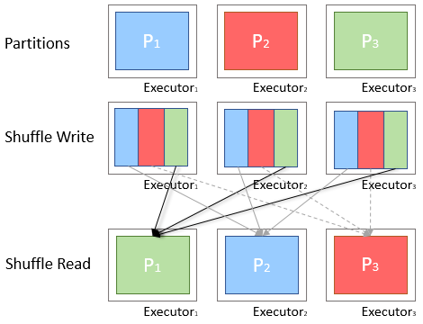

Shuffling
When shuffling, Spark pulls the data from memory to disk, then copies the data from one partition to another.
Input partitions
Shuffled partitions
These partitions often exist on different nodes, creating both disk traffic and network traffic.
https://medium.com

Slide 30
Shuffling
Shuffling is impossible to avoid completely, but there are ways to keep shuffling at a minimum.
Aggregations by partition
Broadcasting
Firstly, aggregations by partition (i.e. group by <partitioned column>), will not shuffle data.
Next, if a table is small enough, we can “broadcast” the table to every node.
Broadcasting a smaller table will also eliminate shuffling when joining with the broadcasted table.

Slide 31
Shuffling
Broadcasting will happen on any table less than 10mb by default:
This can be changed by setting the spark.sql.autoBroadcastJoinThreshold variable to a different size
Changing this setting to -1 will stop all automatic broadcasting.
Spark driver
Job
Job
Executor
Executor
Executor
Task
Task
Task
Task
Task
Task

Slide 32
We can also eliminate shuffling if we filter input data earlier in the program rather than later.

Slide 33
Shuffling
Lastly when Spark shuffles, it creates new partitions based on specific settings. Therefore if we reduce the number of shuffle partitions, we reduce the disk and network burden.
Spark has a setting spark.sql.shuffle.partitions that by default is set to 200, which is much too large for smaller workloads and should be reduced: spark.conf.set("spark.sql.shuffle.partitions", num)
spark.conf.set("spark.sql.shuffle.partitions",100)
println(df.groupBy("_c0").count().rdd.partitions.length)
A good rule of thumb is to set the num argument as 2 times the number of cores in your environment. This is not a hard and fast rule.

Slide 34
Optimizing Spark — Caching

Slide 35
Caching
We will show strategies on how to avoid shuffling and create a better workflow using broadcast and caching.
When data is to be used for subsequent queries AND it’s small enough to fit in memory, caching is a great option.
Caching puts the data into memory and persists in memory until either (a) the system needs the memory or (b) the developer uncache’s the data.
Once we are done with a cached table, it is important to remove it from the cache as soon as possible in order to open up resources for other queries or even more caching!

Slide 36

Caching
However, caching is not an ultimate solution for performance increases.
Do not use cache on dataframes that will not be read frequently as it can impair performance of other queries.
Do not use cache when dataframes are too large to fit in memory.

Slide 37
Caching

Slide 38
Activity: Caching Flight Delays
In this activity, you will use broadcast and caching to avoid shuffling and create a better workflow.
25 Minutes

Slide 39
Notes:
1.3 Review: Practicing parquet Review (0:05)

